Slide 1

Larnaka Municipality
Cyprus
Petros Christodoulou
Deputy Mayor
Barcelona
Tuesday, 19 November 2013
Notes:
I welcome you all to todays presentation My name is ……

Slide 2
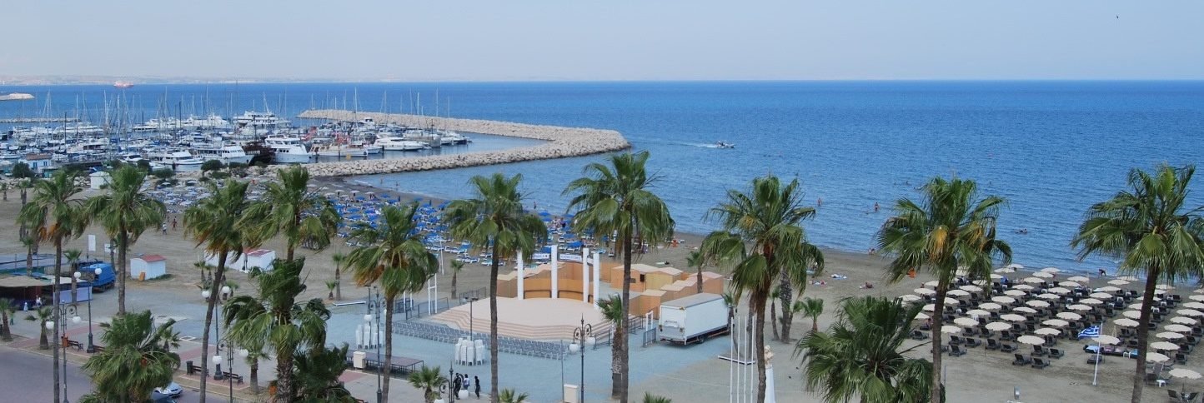
Larnaka at a glance

Slide 3
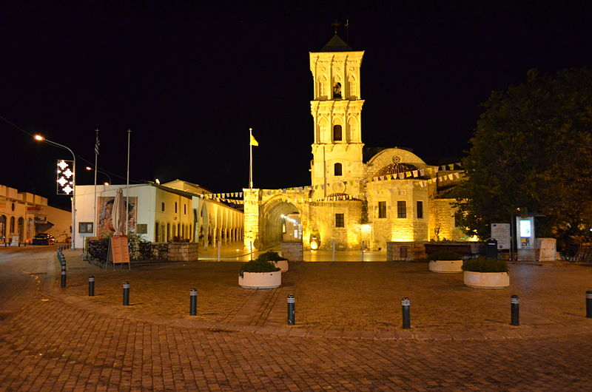
Notes:
St Lazarus Church

Slide 4
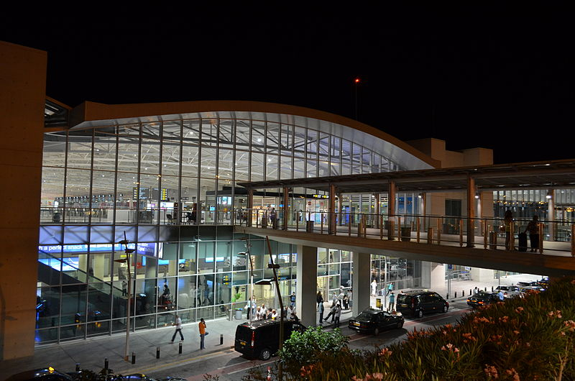
Notes:
Larnaka International Airport

Slide 5
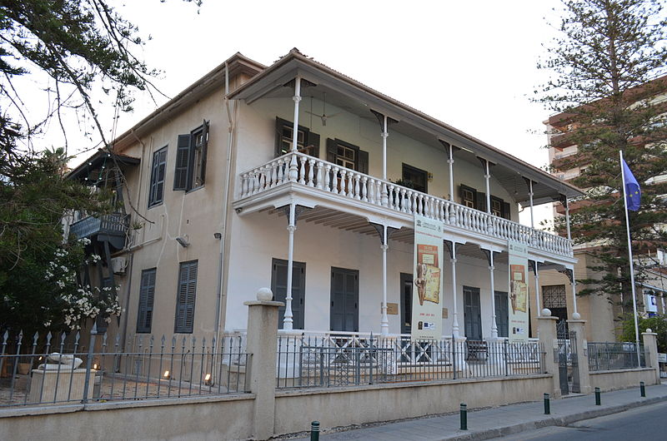
Notes:
Pierides Museum

Slide 6
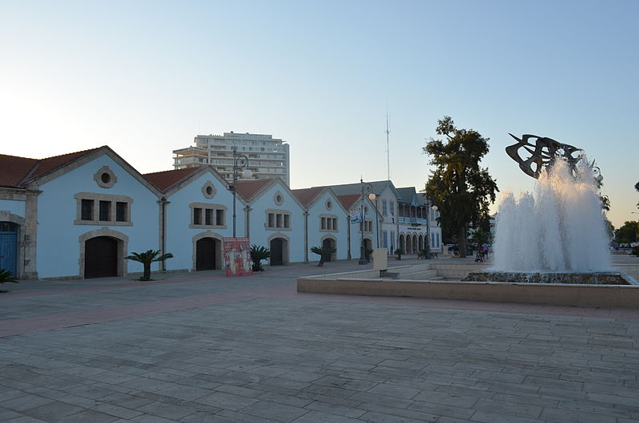
Notes:
Europe square

Slide 7
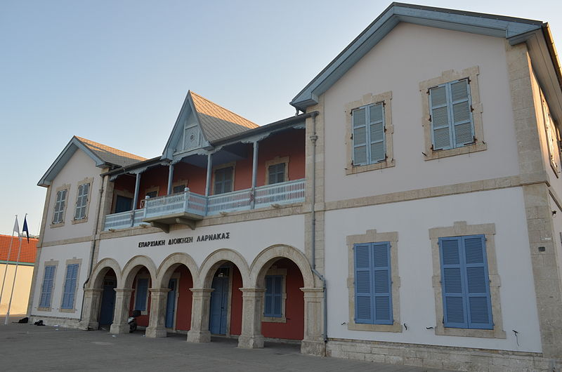
Notes:
Building of District Administration Larnaca

Slide 8
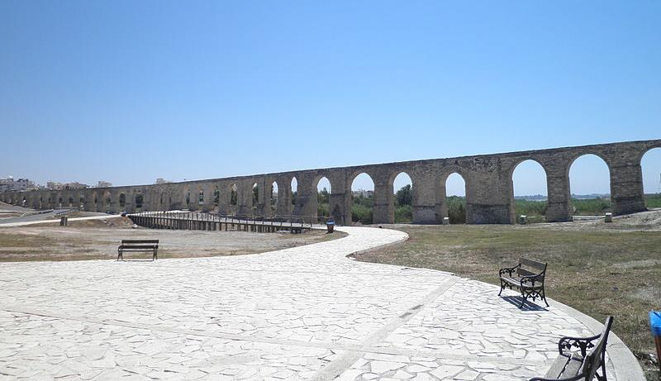
Notes:
Kamares old aqueduct

Slide 9
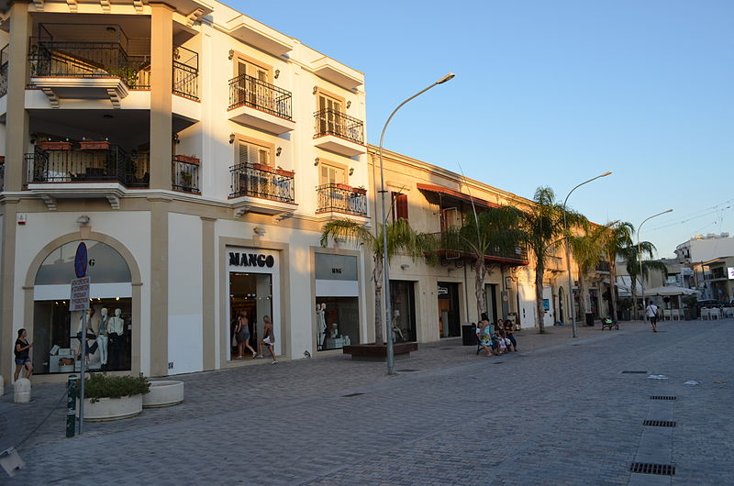
Notes:
Hermes square

Slide 10
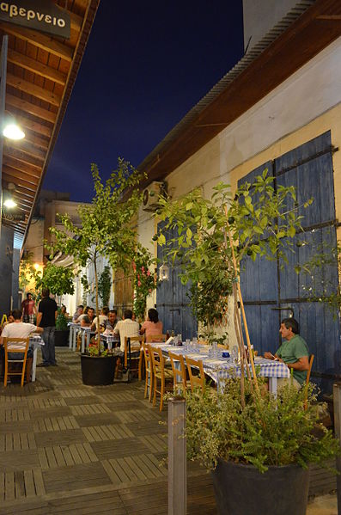
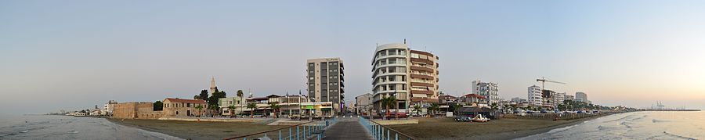
Notes:
Street in town center

Slide 11
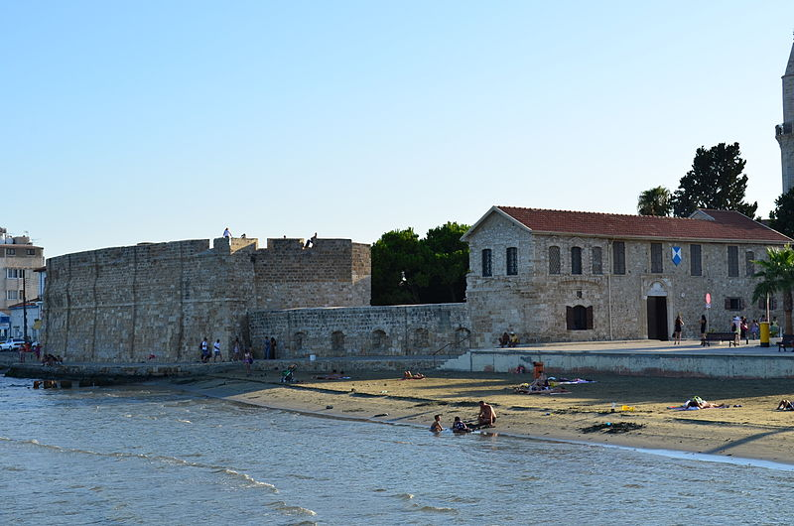

Slide 12
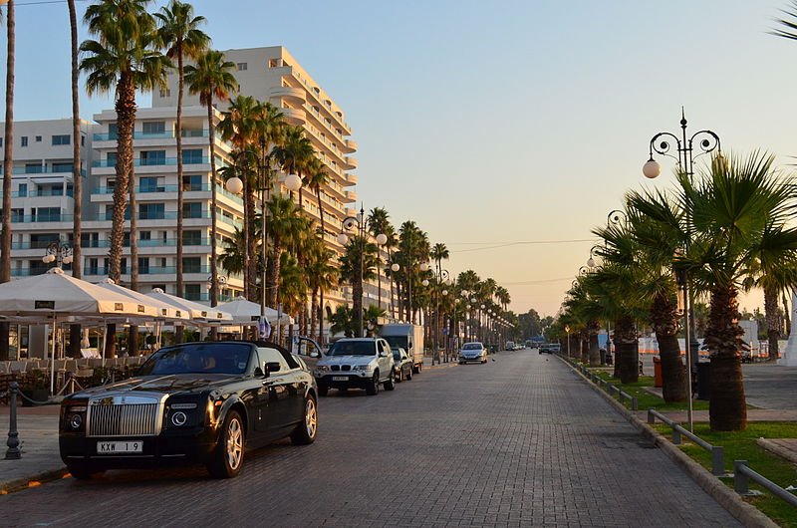

Slide 13
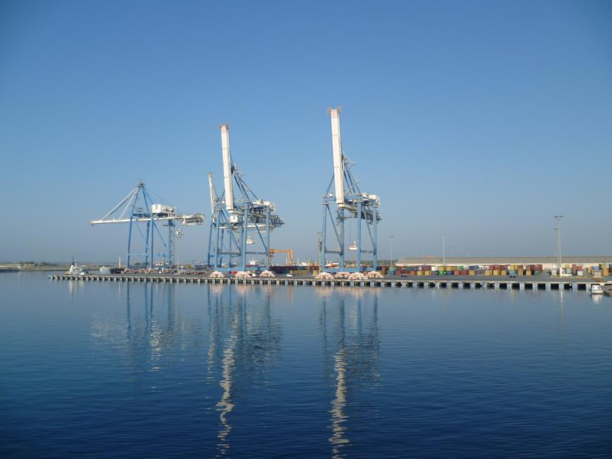
Notes:
Larnaka port

Slide 14
Larnaka Port
The Past ….
Present status
Meeting the future
Notes:
The target of this presentation is to determine Larnaka port’s impact on the daily life of the people of Larnaka and to Cyprus in General. How it helped Cyprus economy in the past years, review it’s role and look forward to the future with a more productive role enhancing it’s activities and becoming a key factor to meet the present needs.
Present schemes in relation to the nearby environment.

Slide 15
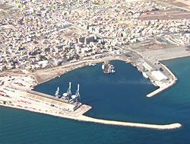
Larnaka port
1973 starts operating
Infrastructure for: industrial business and tourist centre
Only 6 kilometers distance from Larnaca International Airport.
Multipurpose port
Unpacked Loads – Conventional – oil products
Notes:
Until 1973 the port of Larnaka was operating as a roadstead with inadequate port facilities which the town offered in the area where today lays the Marina i.e. at the town center. With the exception of the oil products, the port had served up to that time very little trade traffic and its storage space was quite small and unsuitable.
The new Larnaka port was completed in June 1973 and was initially intended to share with Famagusta port its inland area and supplement the latter. It commenced operation at the end of 1973.
Larnaca's economy has been growing since 1975 after the loss of the Port of Famagusta, which handled 80% of general cargo, and the closure of Nicosia International Airport, meant that Larnaca's airport and seaport had increasingly important roles in the economy of the island.
in 1978, Larnaka port started handling containers as well as other heavy loads in addition to the general cargo
An advantage for the port is the fact that at a distance of 6 kilometers lays Larnaka International Airport.
Today it is a multipurpose port having an area of 445.000 sq. meters and serves all kinds of loads from unpacked (animal fodder, grain, gypsum), conventional (lumber, iron, fertilizers, automobiles) as well as oil products.

Slide 16

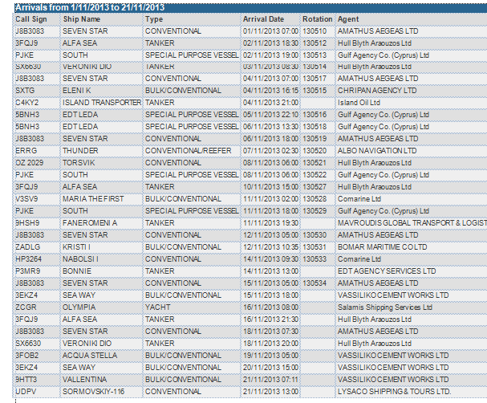
Recent data for Larnaka Port
Notes:
In its present form, Larnaka port is situated approximately 2 km from the town center and on the landside is surrounded by residential units. On the north side there are oil product installations and at the south side it borders with Larnaka marina.
I tried to collect some data from the Cyprus Port Authorities Records in regards to the arrival of ships to Larnaka port from 1st of November till today just to have a picture of the type of activity that the port performs.
As you can see very little (ALMOST ) NO PASSENGERS activity is there.
UNPACKED LOADS, CONVENTIONAL CARGO & OIL PRODUCTS.

Slide 17
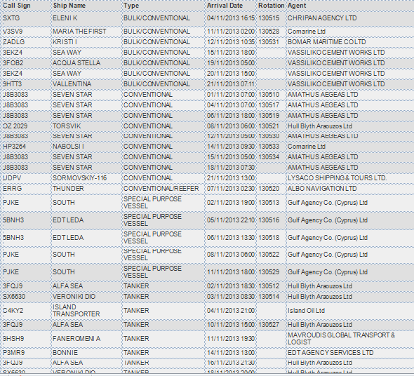
Notes:
IF now we sort this data by type you can see that there is a uniform diaspora of the different type of activity.
UNPACKED LOADS, CONVENTIONAL CARGO & OIL PRODUCTS

Slide 18
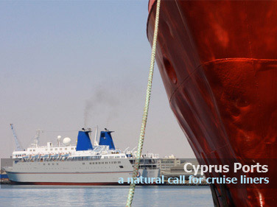

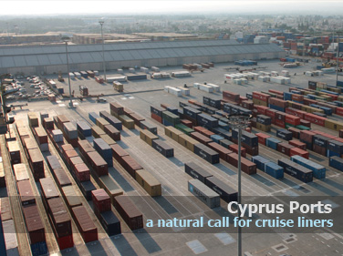
Notes:
NOW WHAT IS NEXT…

Slide 19

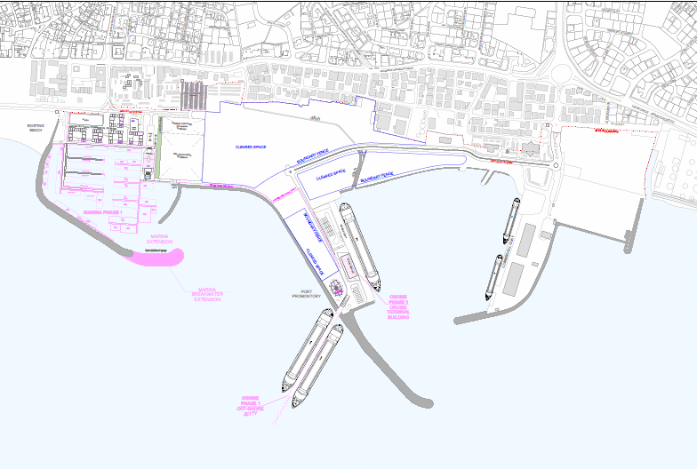
The future …
Notes:
The subject of further development of Larnaca port has seriously preoccupied the Cyprus Ports Authority and the people of Larnaka over the last few years. Following various studies carried out, it has been decided to convert it to the main port for cruise lines and passenger traffic with certain trade activities covering local cargoes and needs. S
ince, at the same time the Government is promoting the idea of developing the Larnaca marina, the Government decided to seek a strategic partner for the development of the port and of Larnaca marina, under the B.D.F.O. method, since both projects have serious synergies as regards the land area.
CYPRUS and the Zenon Corporation have signed a contract for the joint transformation of the Larnaca port and marina, in a project costing in excess of €700 million.
The project is very important for both Larnaca and Cyprus as a whole, noting that such projects will boost the economy and create new jobs at a time of financial recession.

Slide 20
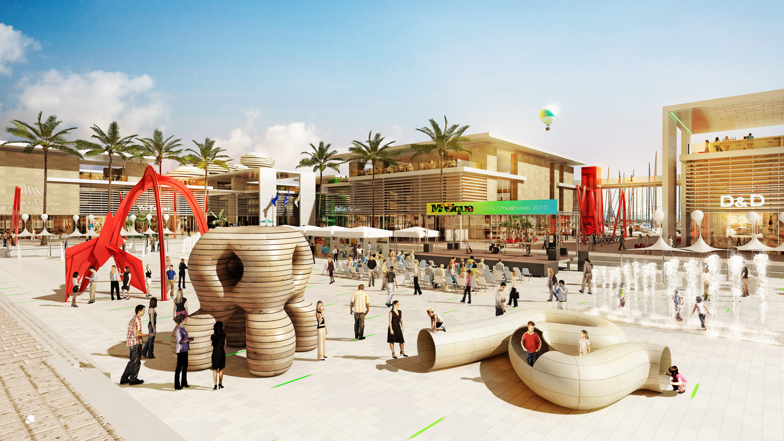
Notes:
The CONCORTIUM will carry out the construction of the new harbour and marina and will manage the facility for a period of 35 years and will also provide land to developers for the construction of residential units that will be sold on a 99 year lease.
Within the framework of a Design-Build-Finance-Operate agreement awarded to Zenon Consortium, led by Bouygues Batiment International in association with eight local and international partners, a new district of Larnaka is about to arise.
The heart of Larnaka will include a brand-new modern marina surrounded by lively commercial and leisure facilities near to the Larnaka beach and in continuity of the Larnaka waterfront promenade, and the new hub for cruises in the Eastern Mediterranean sea to be operated by Louis Cruise and Costa Crociere

Slide 21
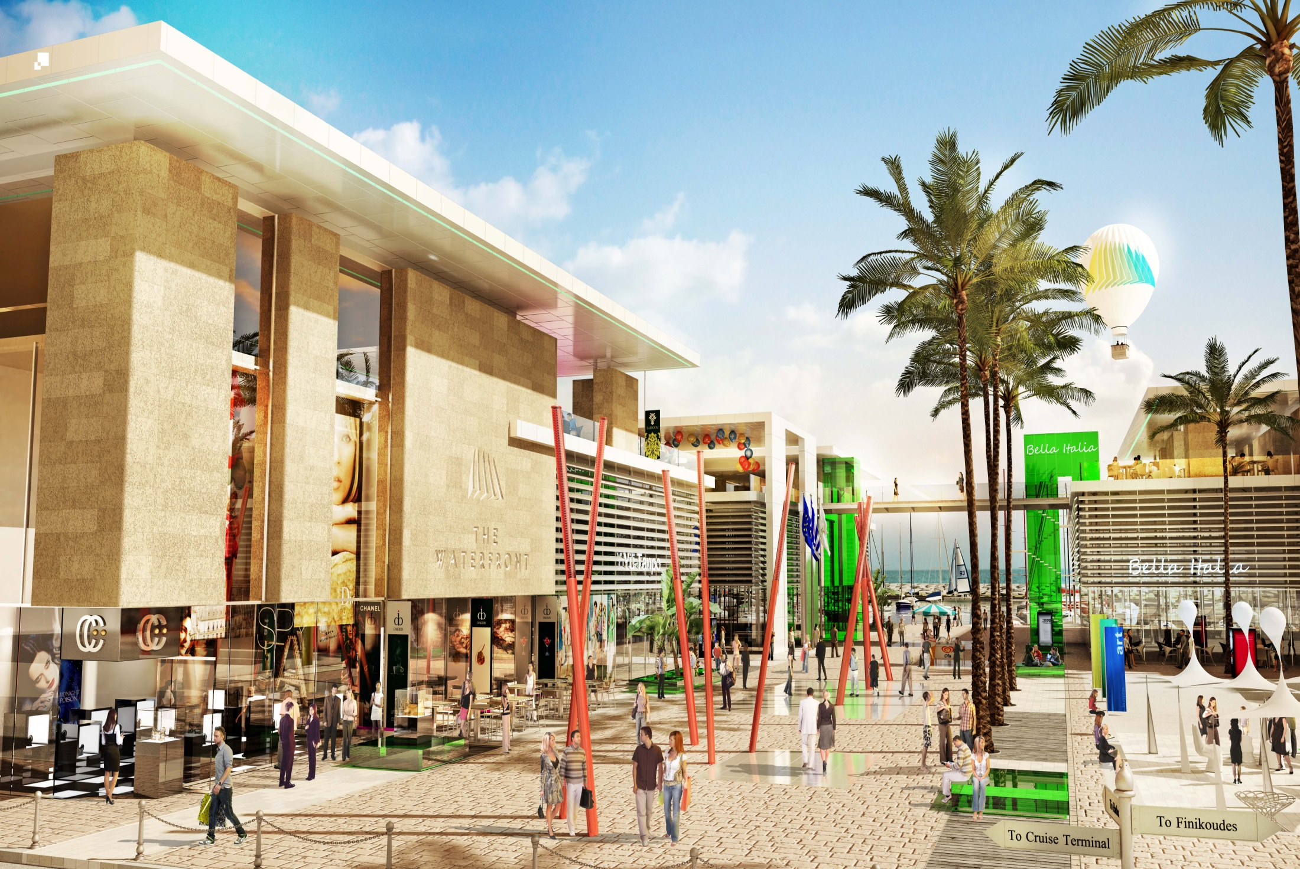
Notes:
The project will be carried out in three phases – the construction of the marina and port infrastructure, including a new passenger pier, an offshore jetty, a yacht club and marina and commercial buildings at an estimated cost of €130 million. Extensions to the port and marina will be constructed at a further cost of €55 million.
Running in parallel with the cruise port project is the building of a new marina, five start hotels, leisure and retail development, all linked via a promenade to ‘down town’ Larnaka and its beaches.

Slide 22
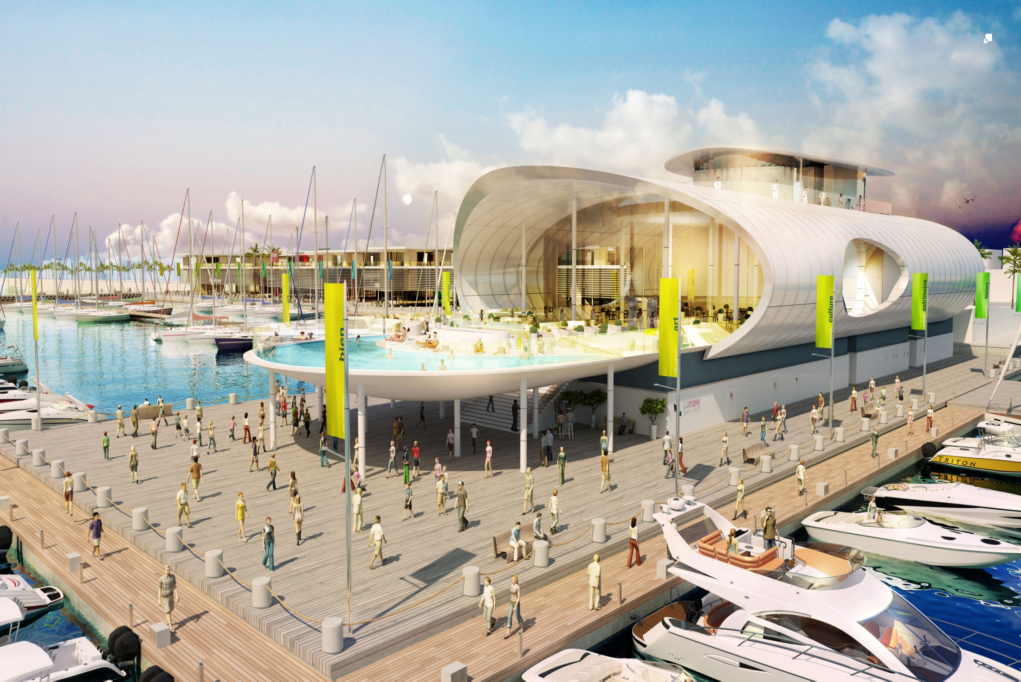
Notes:
Under the agreement, Zenon is required to secure funding for the project within six months, while the first two phases of the project are to be completed within the next three years

Slide 23
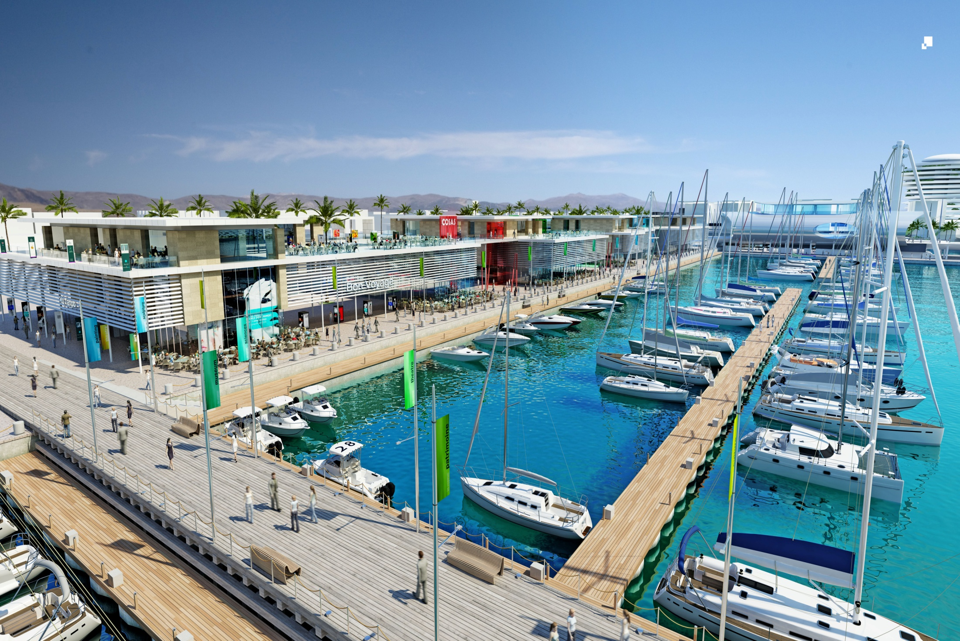
Notes:
The new plan will also provide some of the 200,000 square metres of land designated for the residential developments, bringing its total cost to €700 or €800 million.

Slide 24
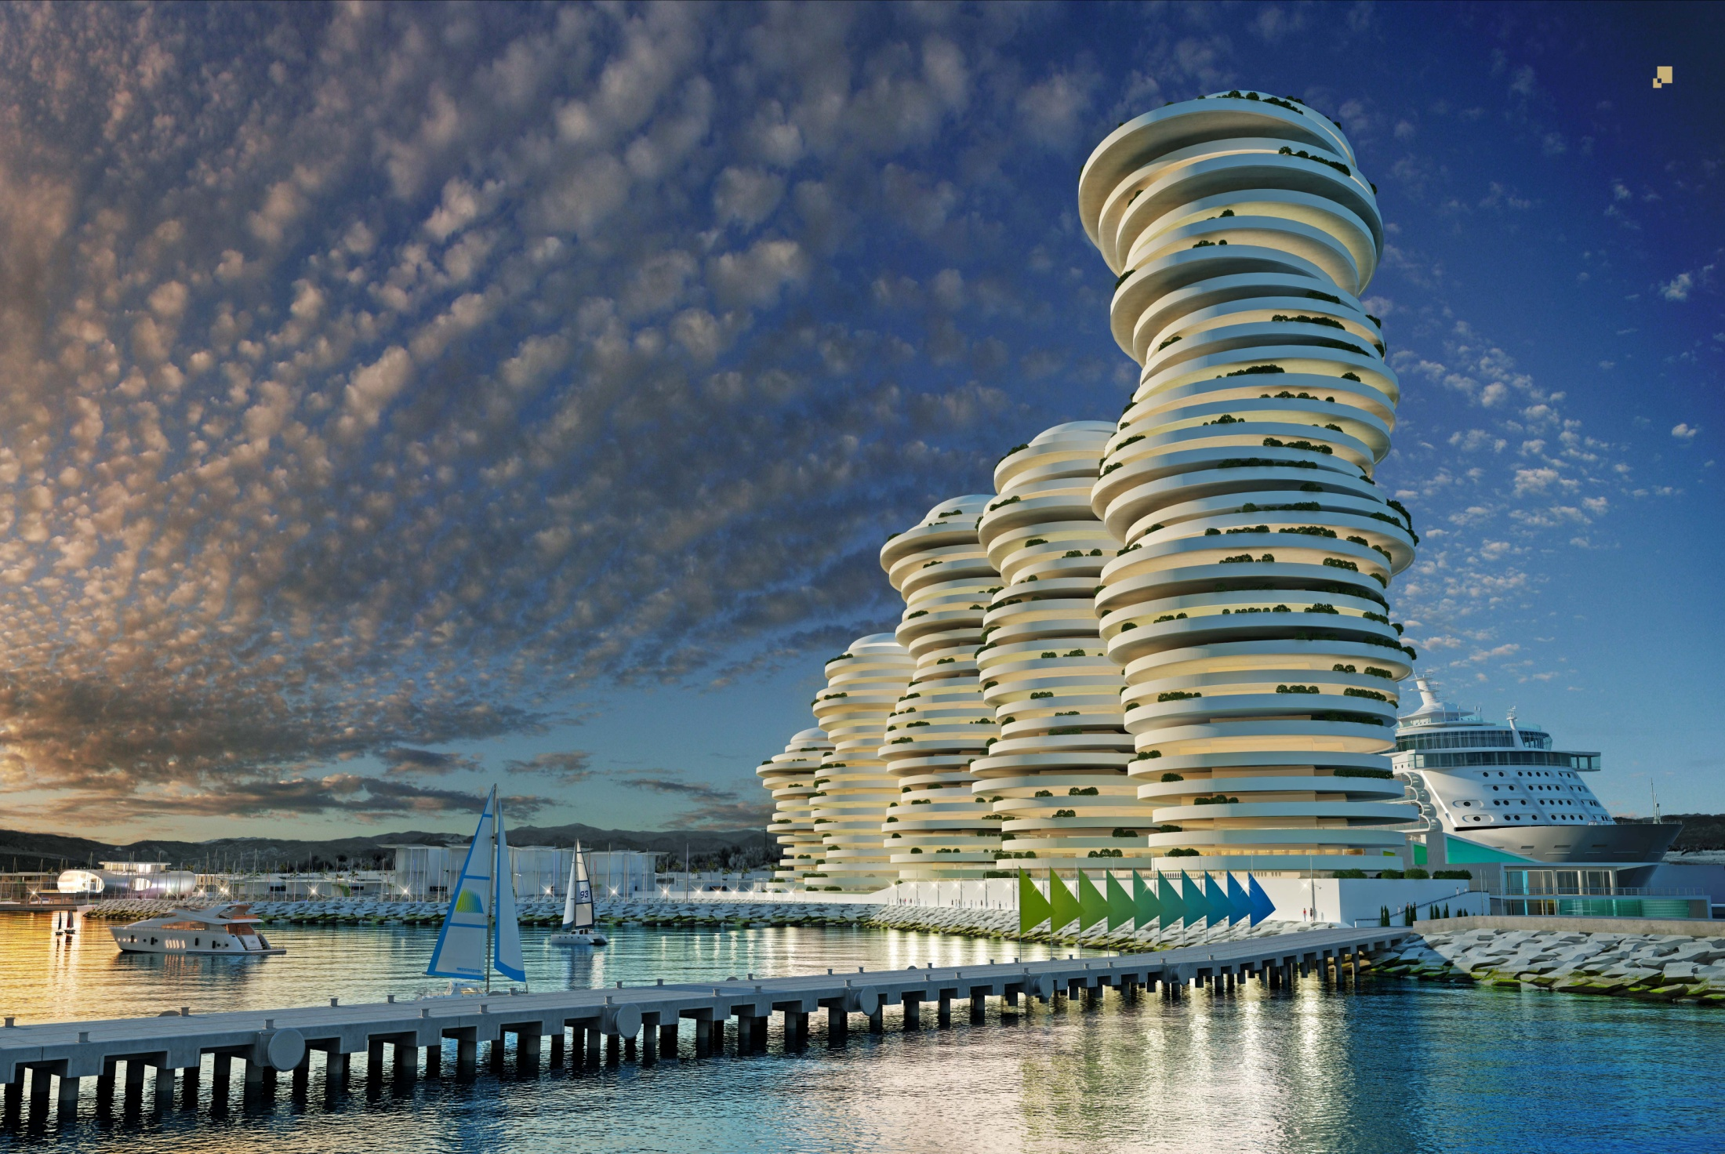

Slide 25
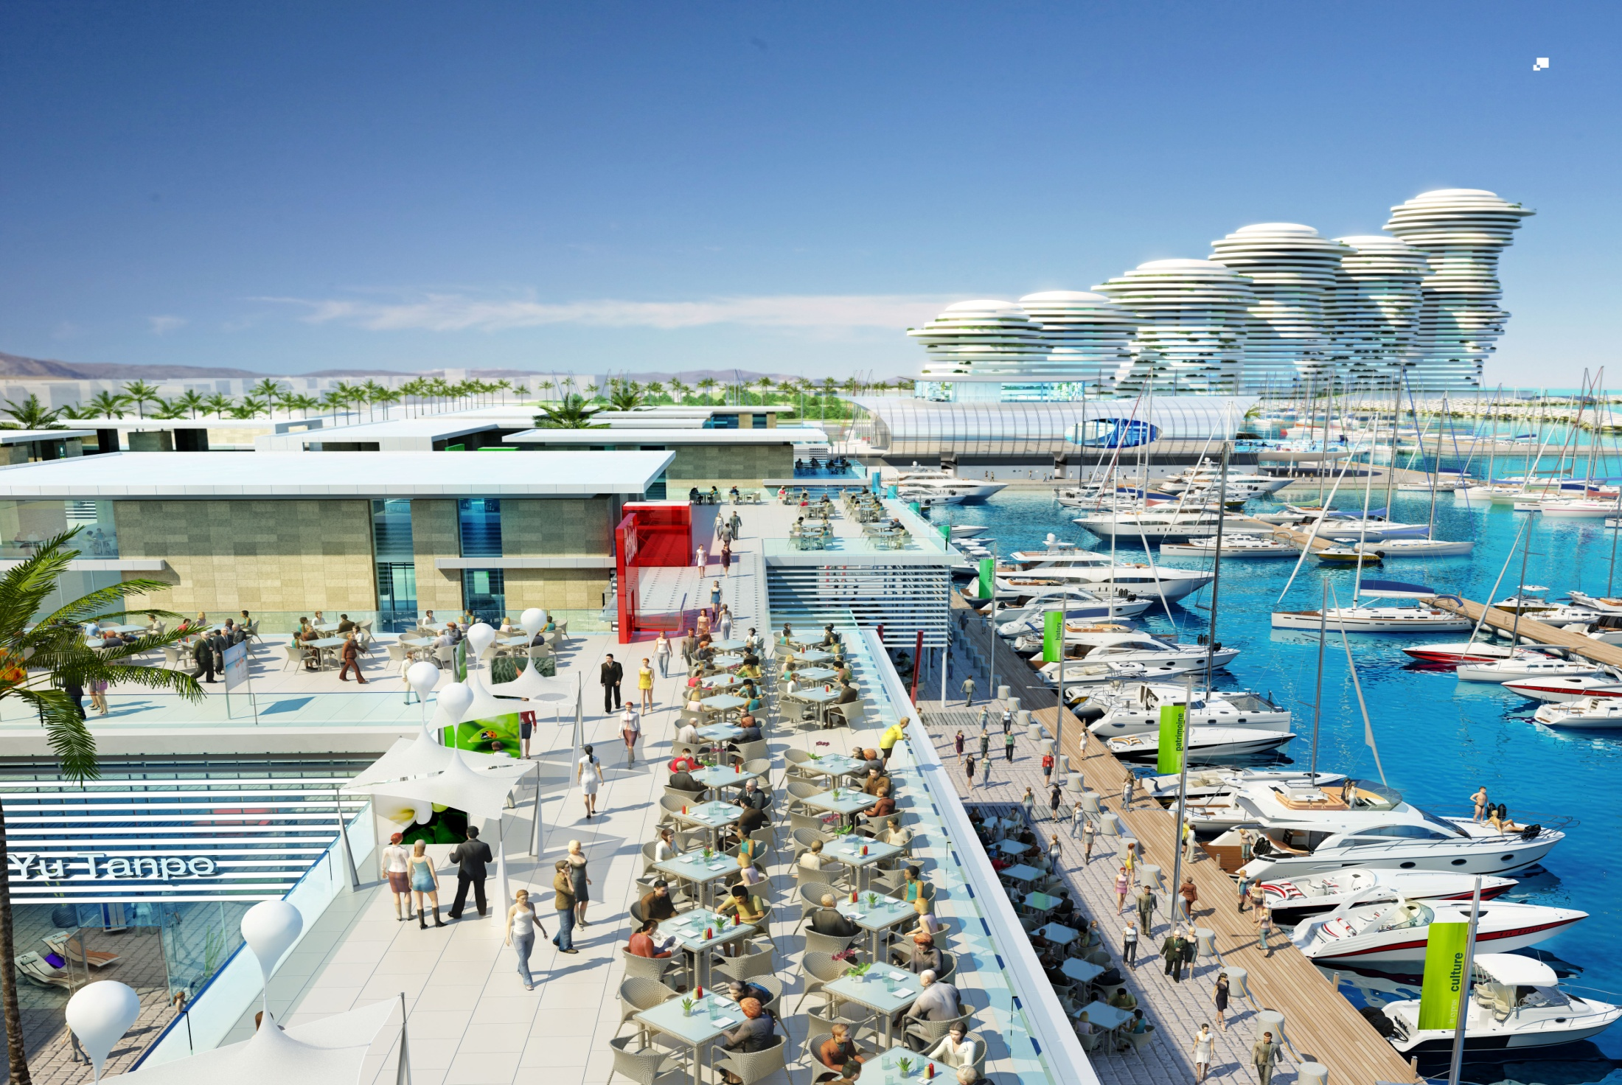
Notes:
Larnaka port can currently accommodate relatively small cruise ships up to 290m at its South Quay with an alongside depth of 11.4m, with smaller vessel using the North Quay which is close to the port’s existing passenger terminal.
The critical factor today in accepting larger cruise ships is the ship’s manoeuvrability. The port’s inner turning circle is for 300m vessels, but the new project expects to increase this to 500m.

Slide 26
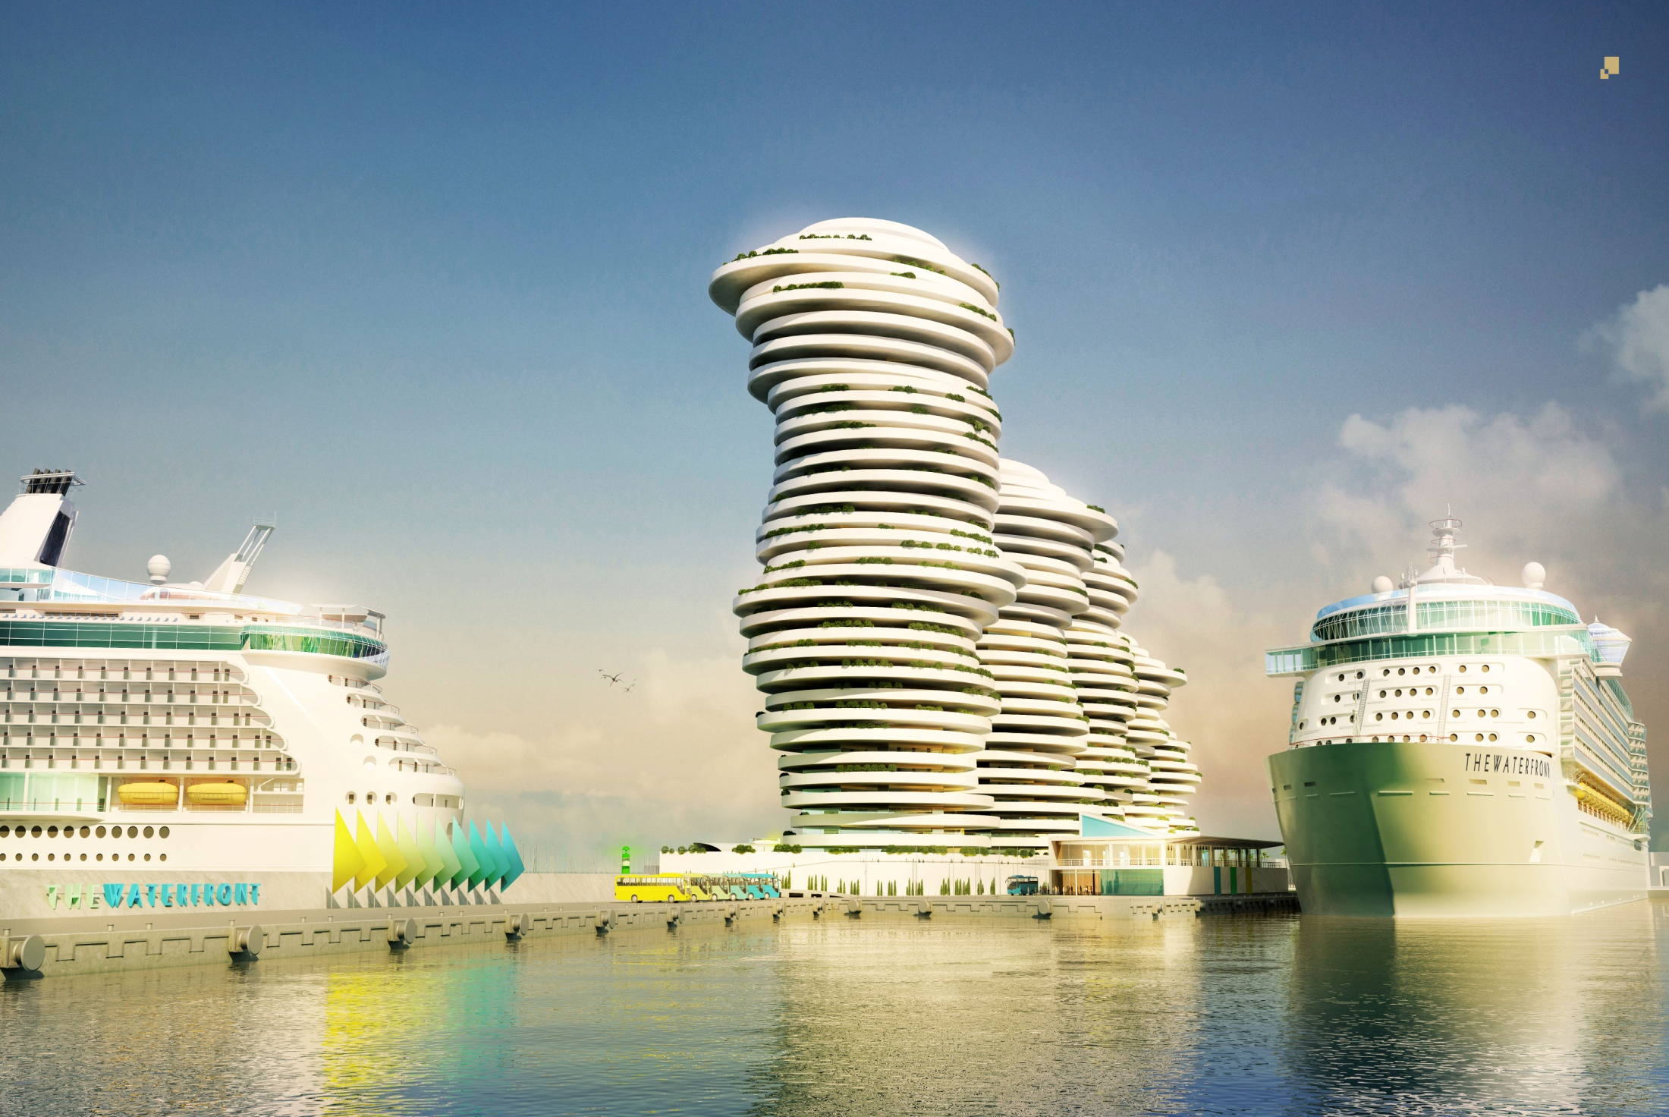
Notes:
‘Larnaka possesses the ideal conditions to become a home port serving the
Eastern Mediterranean,
Greek Islands,
Black Sea and the
Holy Land,
with particular attraction to
British,
German and
Cypriot cruise lines.
The home port advantages of Larnaka are:
close proximity to the most advanced airport in the Eastern Mediterranean;
Walking distance from the port to the town centre;
proactive cultural events organised by the Larnaka Municipality and
an excellent strategic location.’

Slide 27
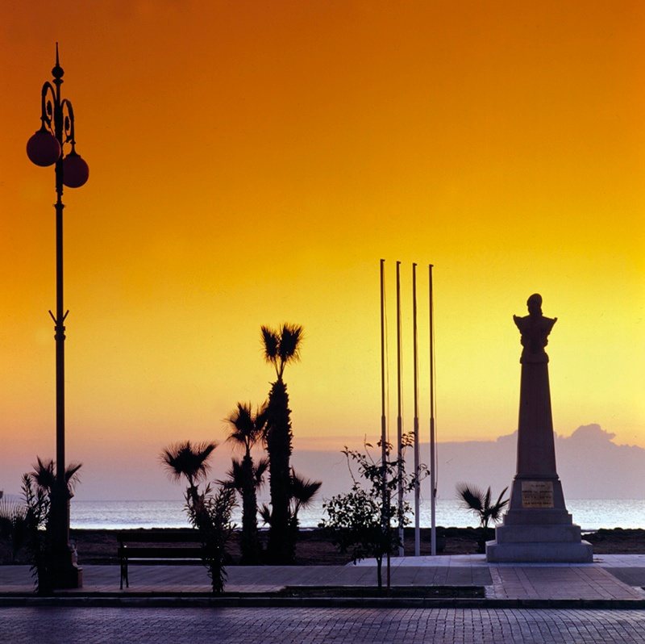
Thanks for your attention!
Petros Christodoulou
Deputy Mayor
Larnaka Municipality-Cyprus

